Slide 1


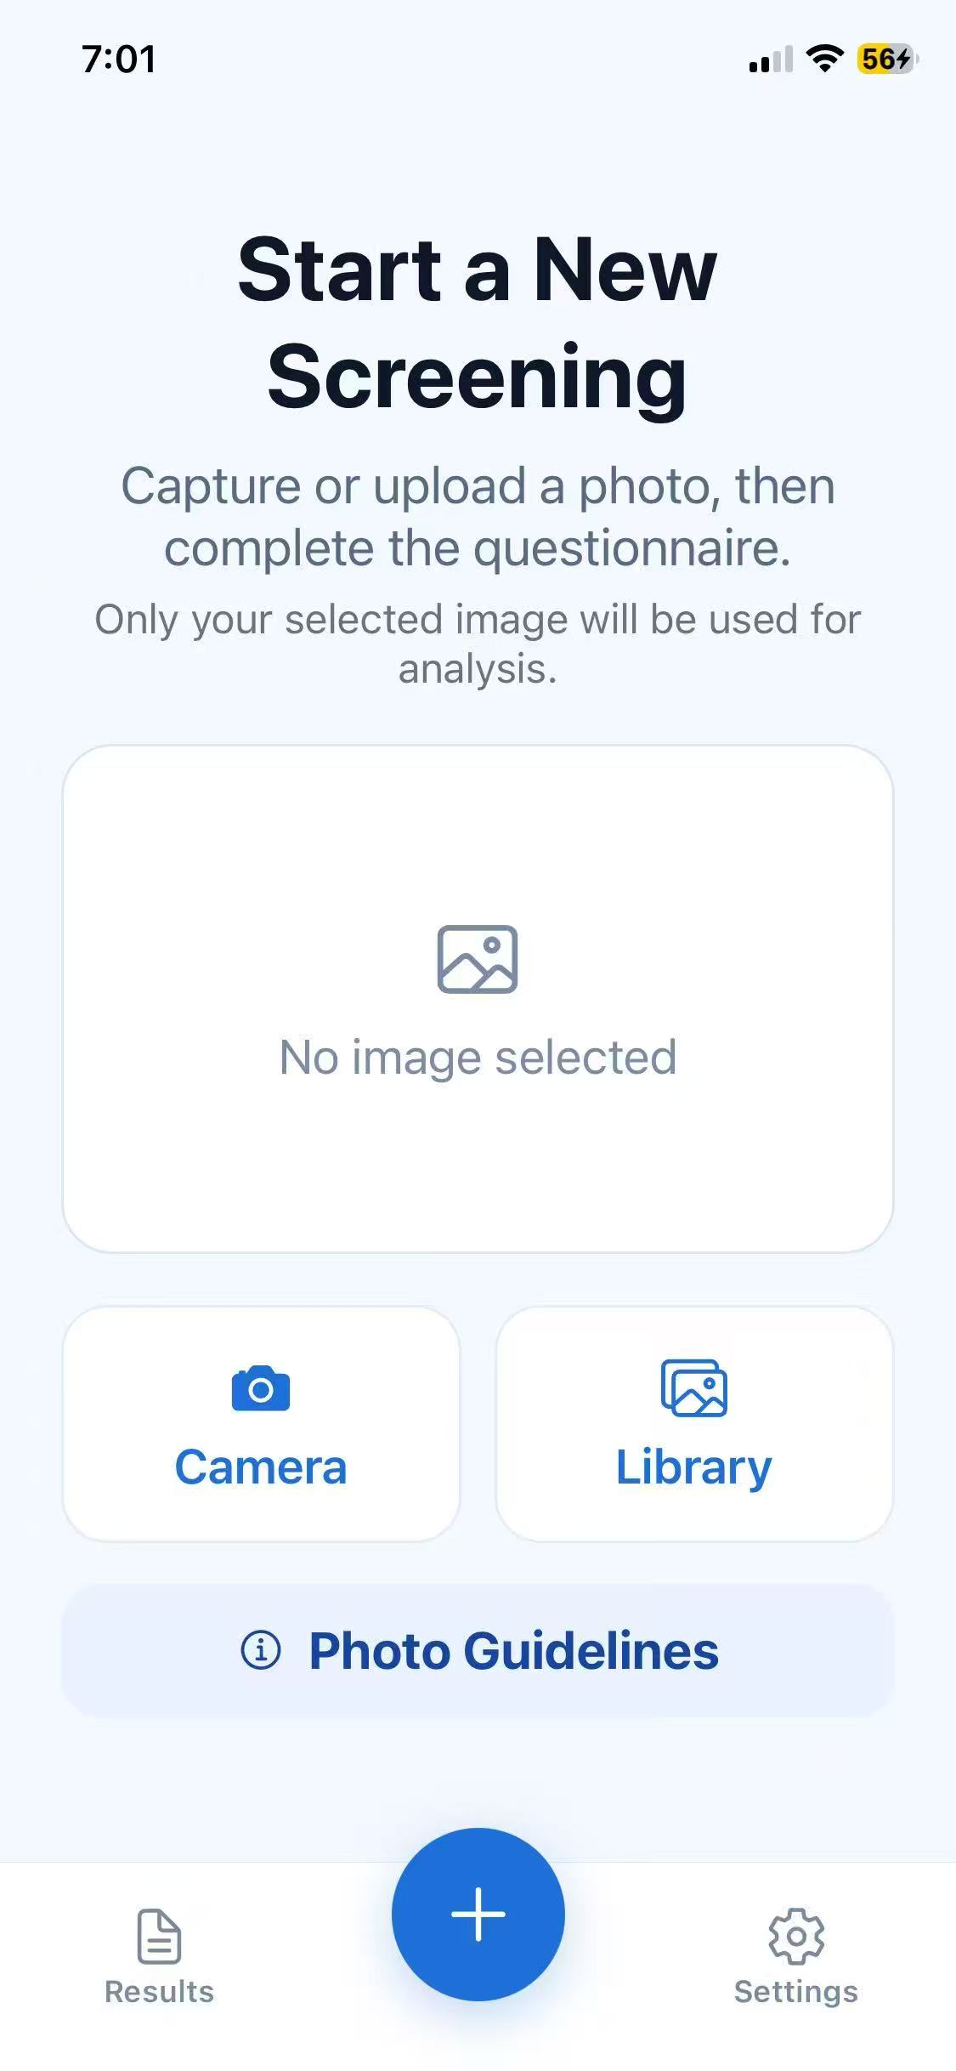
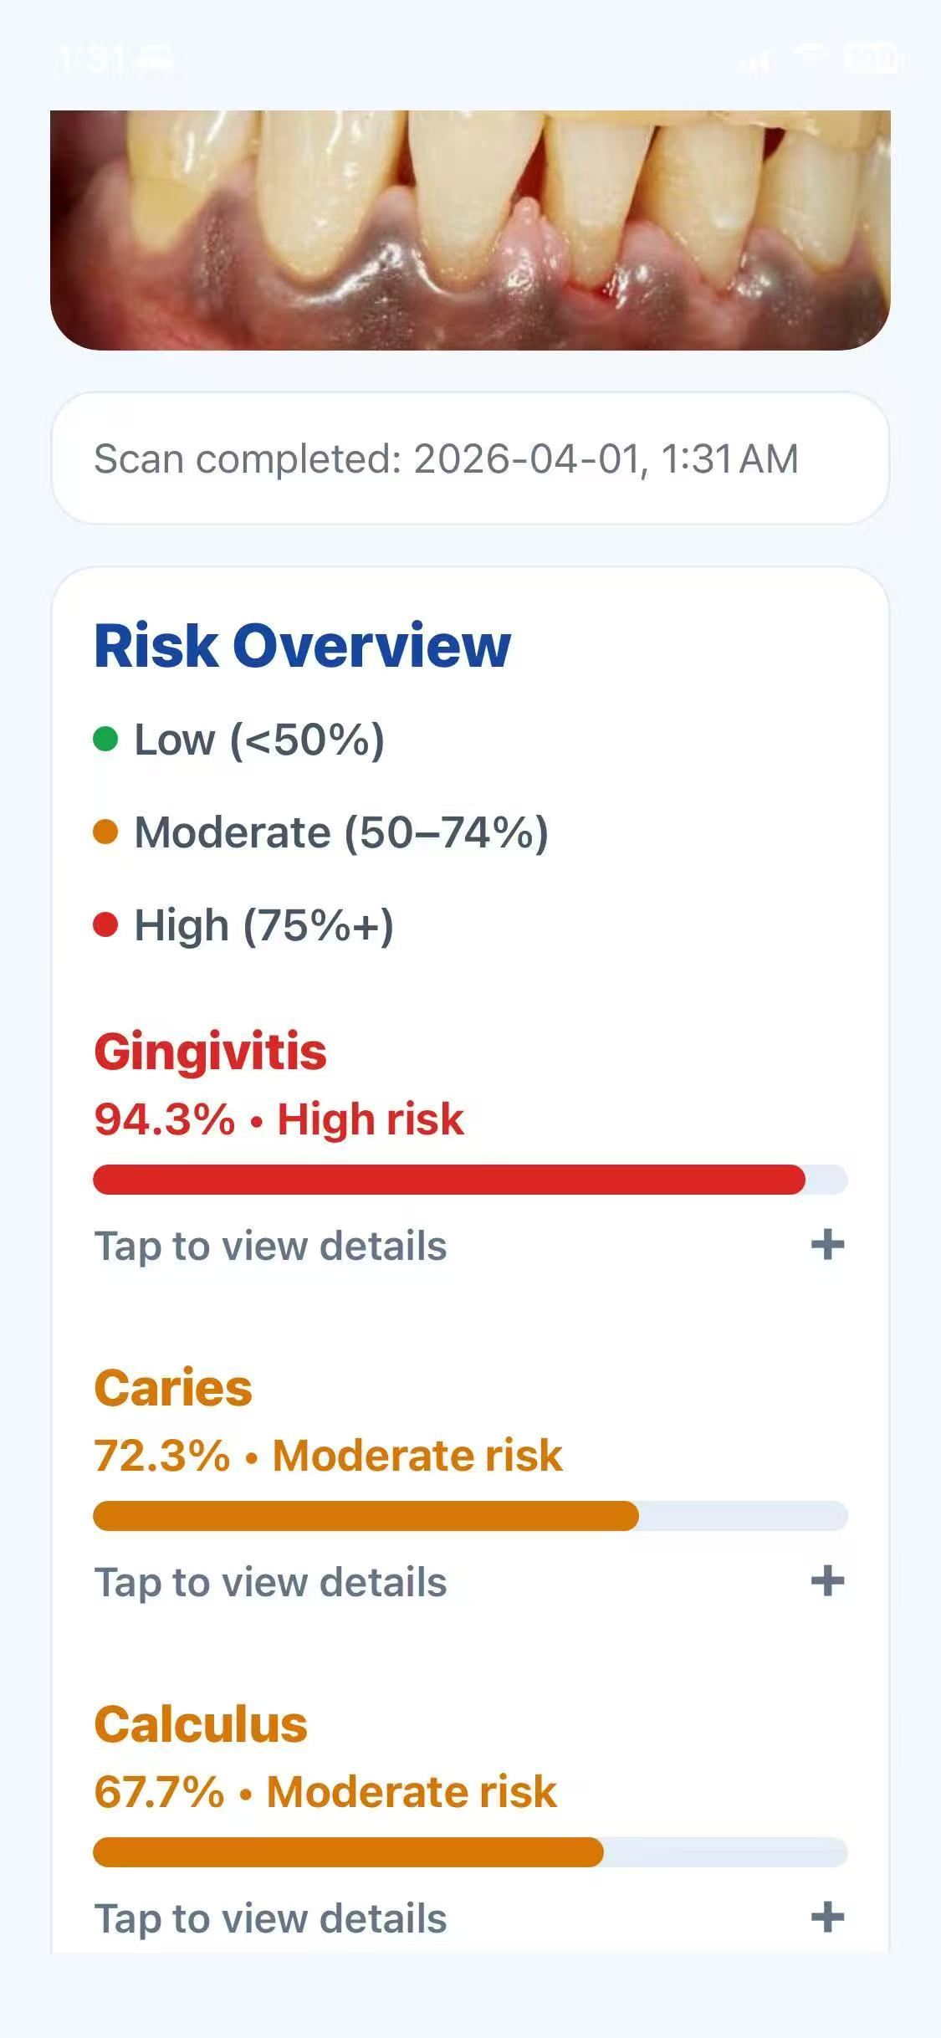
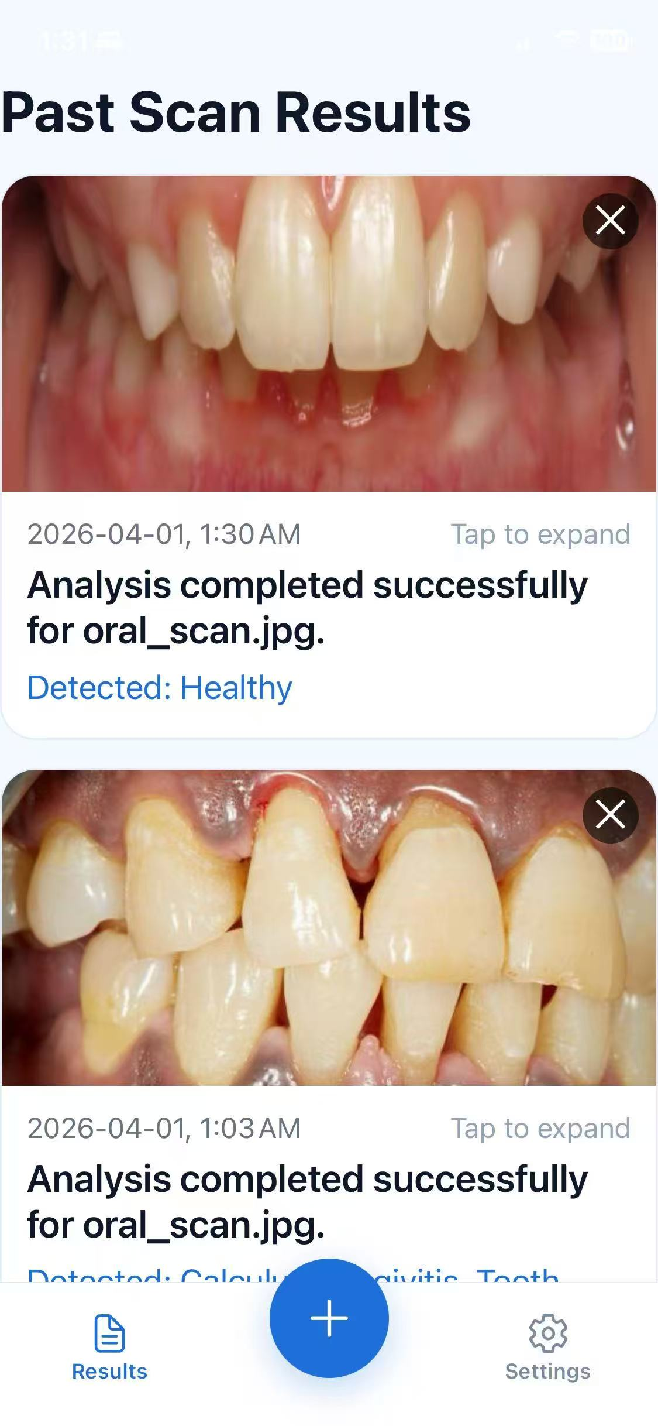
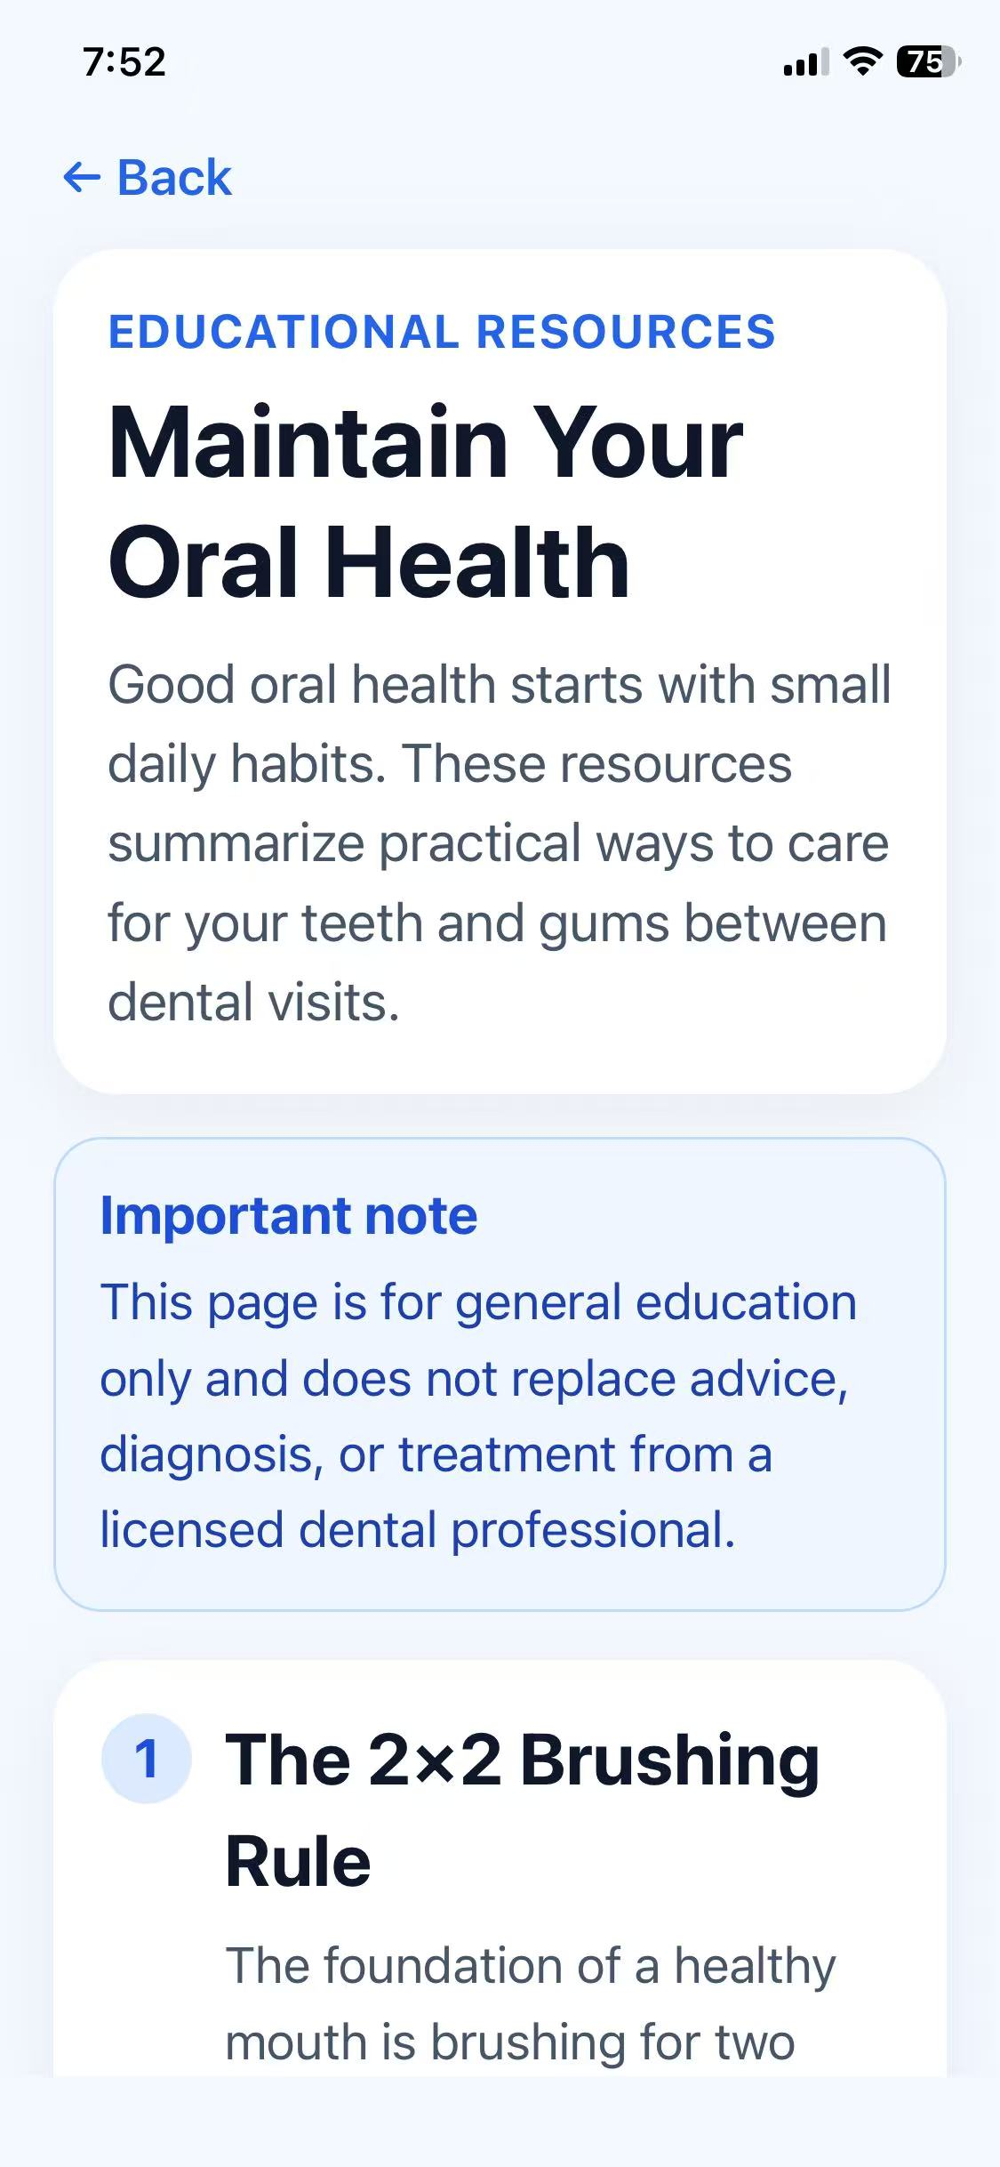
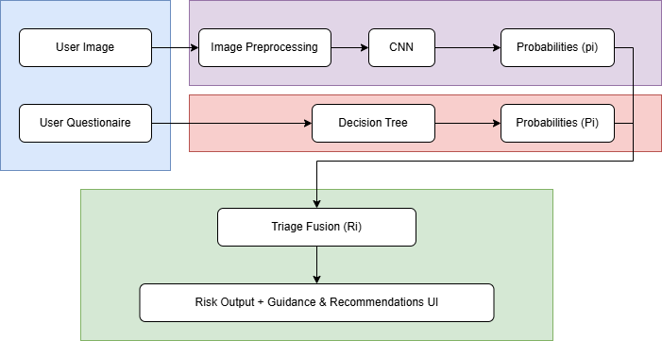
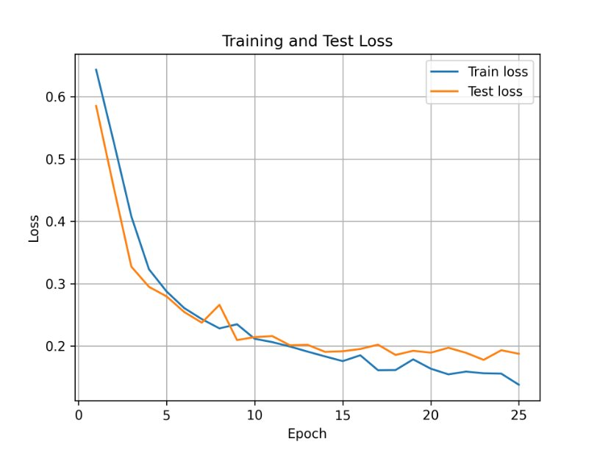
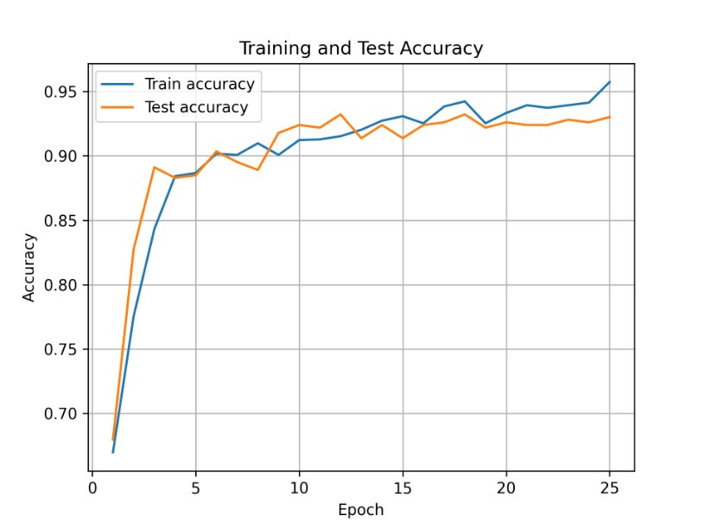
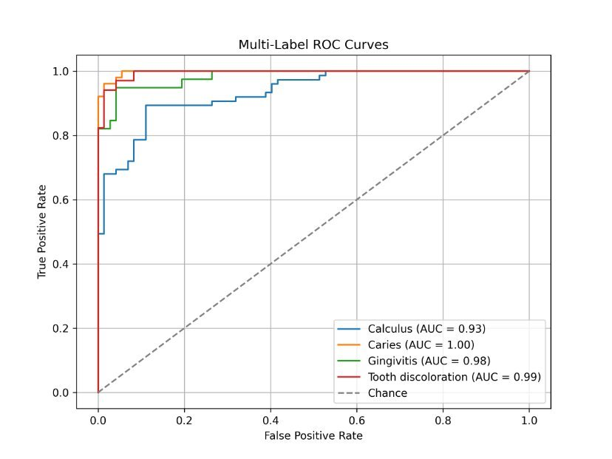
To ensure reliable predictions, an input validation stage is incorporated into the system. Image quality is first assessed based on factors such as clarity and contrast, and a pre-filter model is used to verify the presence of teeth and the gumline. Only images that meet these criteria are passed to the main classification model, which helps reduce false predictions and improves overall system reliability.
SELFIE: Mobile AI Dental Assistant for Oral Condition Screening
Combining Deep Learning and Questionnaire-Based Risk Assessment
Jasmine Wang & Ruidi Liu
Introduction
Preprocessing
Frontend Integration
Oral diseases affect ~3.7 billion people worldwide [1]
Untreated conditions can reduce quality of life
Many cases are preventable, but care is delayed due to [2][3]
Cost
Limited access
Lack of awareness
Dental anxiety
Early detection is critical Enables simpler treatment
Improves long-term outcomes
Traditional diagnosis requires clinic visits & equipment
Proposed solution:
Mobile-based screening system
Image-based deep learning + risk questionnaire
Improves accessibility and early detection
Input validation stage ensures reliable predictions
Image quality checked (clarity, contrast)
Pre-filter verifies teeth and gumline presence
Invalid images are rejected early
Valid images sent to classification model
Reduces false predictions, improves reliability
Mobile-First Design
Intuitive, accessible experience using React Native (Expo Go)
Frontend (React JS/TS) handles UI, collects images and questionnaire responses
Sends data to backend via secure REST API
Backend (FastAPI) performs image preprocessing and AI inference efficiently
Generates probability scores and detected oral conditions before sending back to the front end for display
Results Display shows risk levels, detected conditions, and recommendations
Testing & Iteration: paper prototypes → Figma → working application
User Feedback collected continuously to improve interface and workflow
Scalability, Maintainability & Focus, separation simplifies updates, ensures user-centric design
Visual Model (Deep Learning)
Visual model based on MobileNetV3 Small (transfer learning)
Designed for efficient oral image analysis
Images processed:
Resized to 224 × 224
Normalized (ImageNet statistics)
Augmented (rotation, flipping, brightness)
Architecture:
Frozen backbone
Custom classifier head
Uses masked multi-label approach
Relevant labels used；Unrelated labels ignored (-1)
Trained with masked binary cross-entropy
Optimized using Adam optimizer for stable learning
UI / UX
Objective
Develop a hybrid system for detecting common oral conditions
Targets: calculus, caries, gingivitis, tooth discoloration
Combines:
Image-based deep learning
Questionnaire-based risk assessment
Designed to be accessible and low-cost
Supports early detection and awareness [4]
Focuses on people with limited access to dental care
Questionnaire
System Design
Questionnaire model estimates risk from patient inputs
Inputs: hygiene, sugar intake, dental visits, symptoms, history etc.
Responses form a weighted risk score
Converted to probabilities using sigmoid function
Captures non-visual risk factors to increase generalizability
Combined with image model via weighted fusion
Outputs final risk predictions
Client Server Architecture:
User inputs: oral image + questionnaire
Image → deep learning model
Responses → risk assessment decision tree
Outputs combined via fusion layer
Risk results + personalized recommendations shown to user
Figure 3. SELFIE Application User Interface. (a) Landing page, (b) Results display, (c) Patient history tracking, (d) Educational resources. The interface is designed to provide accessible screening, result interpretation, and user guidance.
Results
Future Considerations
Future work will focus on expanding the dataset with fully labeled conditions, improving model performance and learning relationships between co-occurring diseases.
Addition of more oral conditions, extending diagnostic capabilities.
Incorporating condition-specific thresholds to reduce false positives while maintaining high sensitivity.
Future development may include real-world deployment, user interface design improvement, and system integration into mobile health platforms for broader accessibility.
Figure 1. System Architecture highlighting components and workflow
Figure 2. Evaluation Metrics for Visual Model. (a) Training and Test Loss, (b) Training and Test Accuracy, (c) Multi-label ROC Curves. Average 92% Model Accuracy and 0.97 Average AUC across the four conditions.
References: [1] World Health Organization, “Oral health,” Fact Sheet, 2025. [Online]. Available: https://www.who.int/news-room/fact-sheets/detail/oral-health. Accessed: Oct. 24, 2025.
[2] G. Isola et al., “Periodontal health and disease in the context of systemic …”, *Journal Name*, 2023. [Online]. Available: https://pmc.ncbi.nlm.nih.gov/articles/PMC10199803/. Accessed: Oct. 24, 2025.
[3] Institute of Medicine (US) & National Research Council (US) Committee on Oral Health Access to Services, *Oral Health in America: Advances and Challenges*, National Academies Press (US), 2021. [Online]. Available: https://www.ncbi.nlm.nih.gov/books/NBK576536/. Accessed: Oct. 24, 2025.
[4] “Early detection and treatment of dental issues: The key to optimal oral health and well-being,” Excel Dental, [Online]. Available: https://exceldental.ca/general-dentistry/early-detection-and-treatment-of-dental-issues-the-key-to-optimal-oral-health-and-well-being/. Accessed: Oct. 24, 2025.

